Slide 2


Azure AI Landscape
@
/in/

Slide 3
The Terminologies
Artificial Intelligence
Any technique that enables computers to mimic human behaviour.
Machine Learning
Ability to learn without being explicitly programmed.
Deep Learning
Learn underlying features in data by using neural networks.

Slide 4
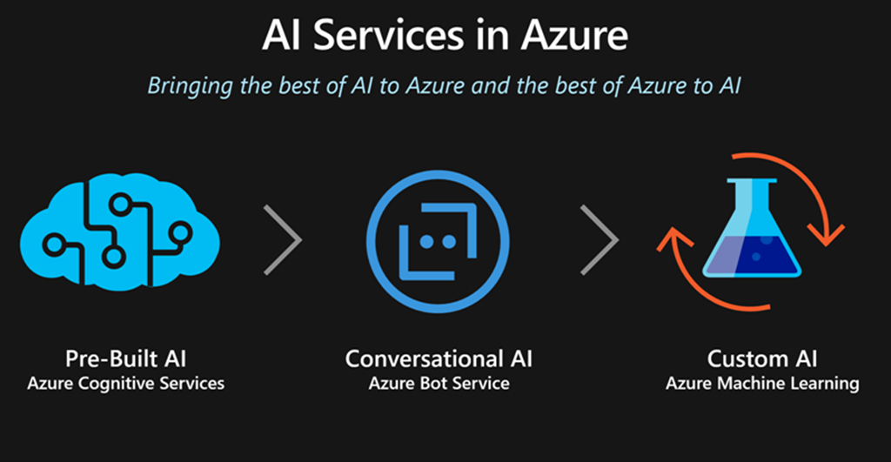

Slide 5
The Azure AI Landscape
Applications
Use AI
Artificial Intelligence in Applications
Cognitive services
Bot framework
Knowledge
Include AI
Artificial Intelligence from Pre-built Services, Apps, and Knowledge Mining
Machine Learning Services, Pretrained Models, Frameworks and Infrastructure, IoT
Create AI
Artificial Intelligence with Platforms, Infrastructure and Tools, Deploy to Edge
Azure Databricks
AI Solutions Gallery
Find AI
Artificial Intelligence Solutions in a Portal

Slide 6
Use AI - Agent
Cortana
1,000+ skills and knowledge, 133 million users | 12 billion questions

Slide 7
Use AI - Applications
Office 365
Skype
Dynamics 365
Teams
SwiftKey
Calendar.help
Pix
Customer Service and Support

Slide 8
Include AI - Services
Cognitive Services
Cognitive Services Customizations
Bot Framework
Knowledge Mining

Slide 9
Create AI - Infrastructure and Tools
Data Science Process
Pretrained Models
Azure Databricks
Services and Frameworks
Infrastructure

Slide 10
Find AI - Solution Portal

Slide 11
